Slide 1

MyTaskify-The Task Manager
Project Supervisor: Ms. SANKARI M.
Name of the Student: KUMAR APOORVA
Register Number: 39110545
12 April 2022

Slide 2
Presentation Outline
Problem Statement & Solution
Objectives
Ideation Map
Architecture Diagram
Software and Hardware Requirements
Application Snapshots
Learning Outcome and Result
Conclusion & Future work
References
12 April 2022

Slide 3
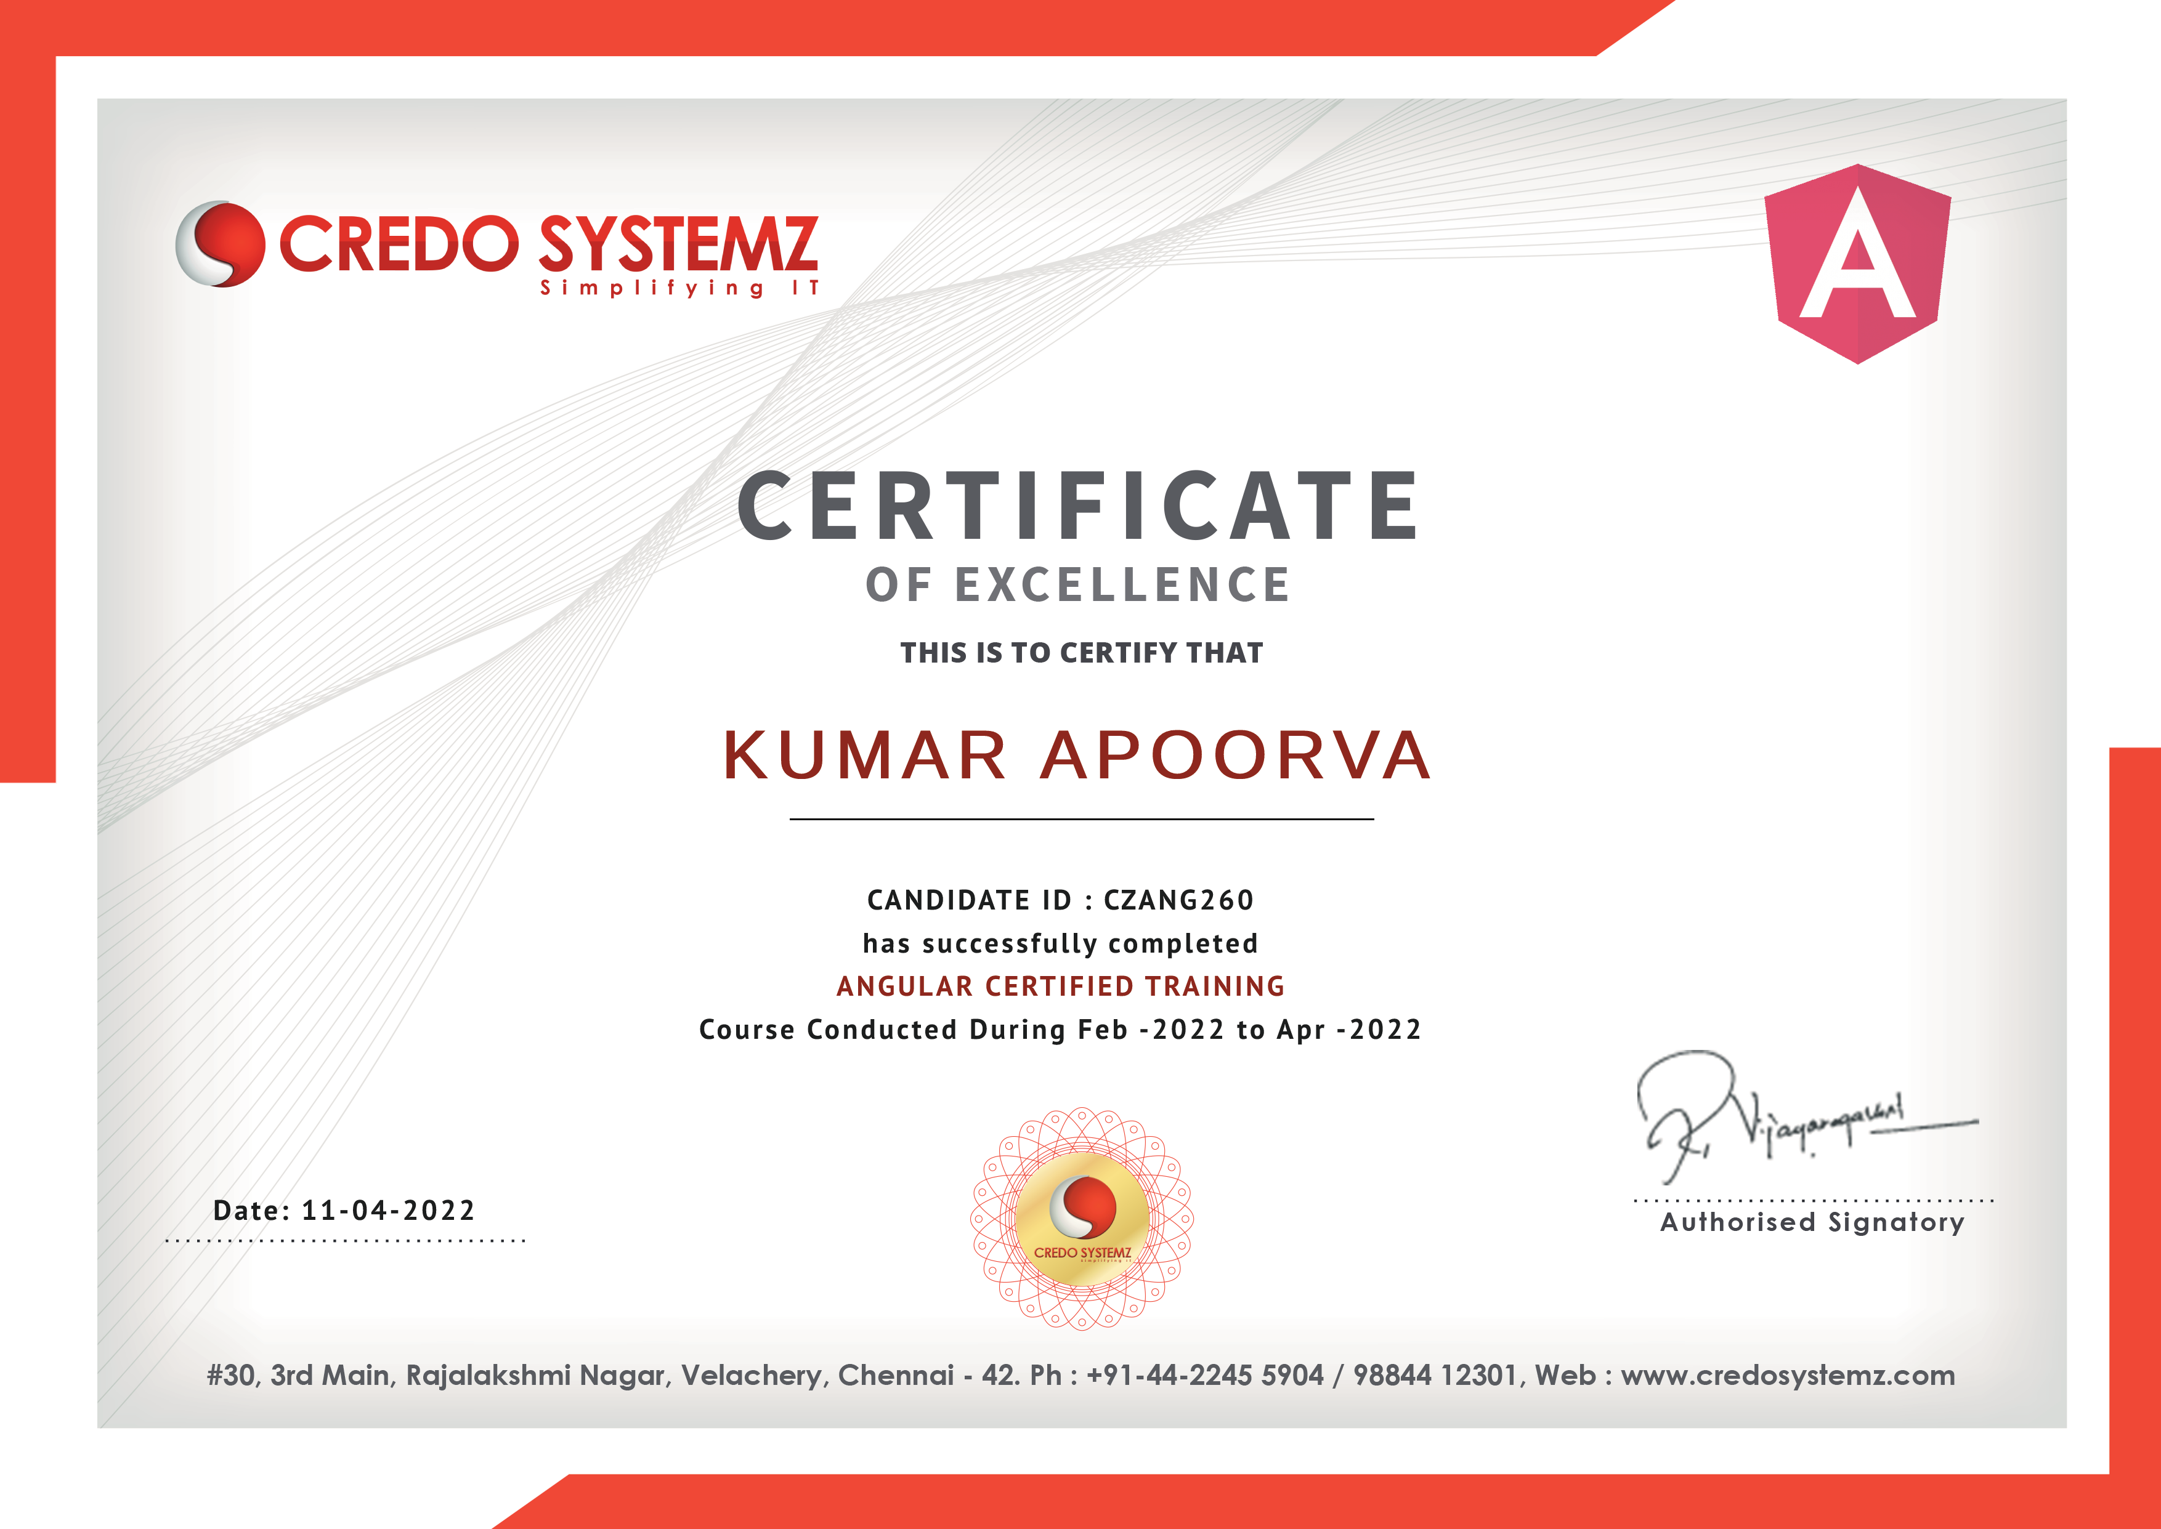
Certificate
12 April 2022

Slide 4
Problem Statement & Solution
Problem Statement:
To create a task management application that will help the user to complete their work on time, it will also enable him/her to increase their productivity and save time.
Solution:
MyTaskify-The Task Manager
12 April 2022

Slide 5
Objectives
To make a Task Manager Application for helping the user to complete task on time.
To Increase Productivity
To Achieve the day-to-day goals
12 April 2022

Slide 6
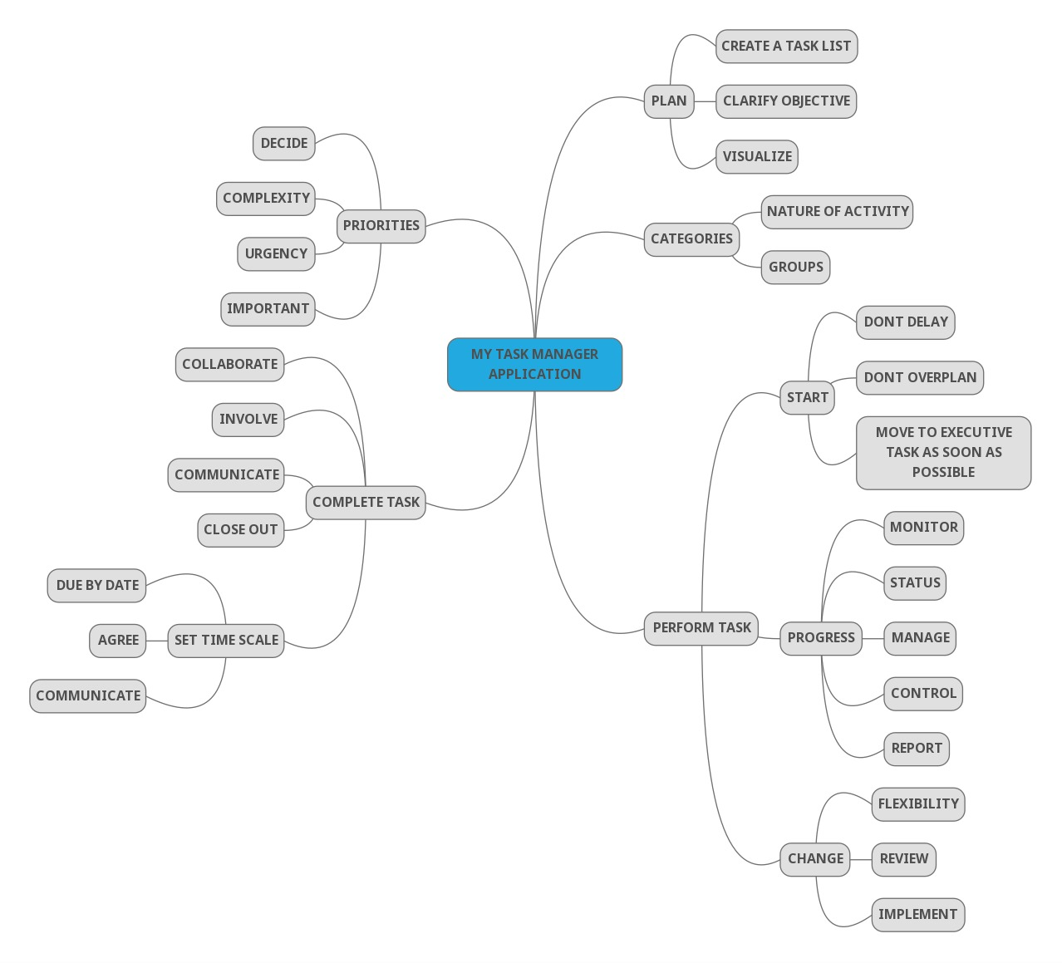
Ideation Map
12 April 2022

Slide 7
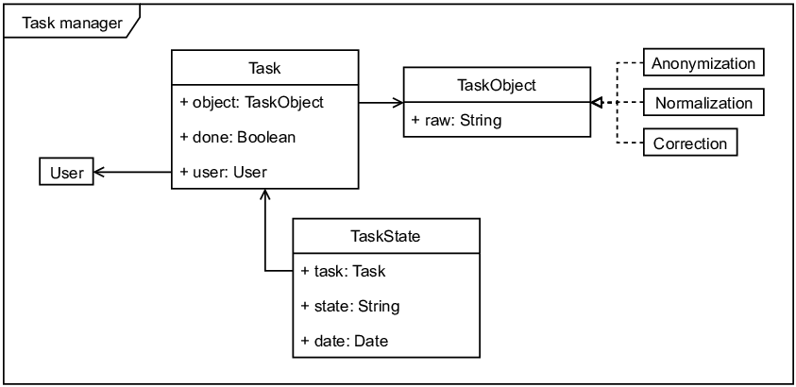
Architecture Diagram
12 April 2022

Slide 8
Software and Hardware Requirements
Software Requirements
VS Code
NodeJS
Latest version of Google Chrome
Hardware Requirement
A laptop/ PC with updated version of Windows or MAC OS, to install and run NodeJS.
12 April 2022

Slide 9
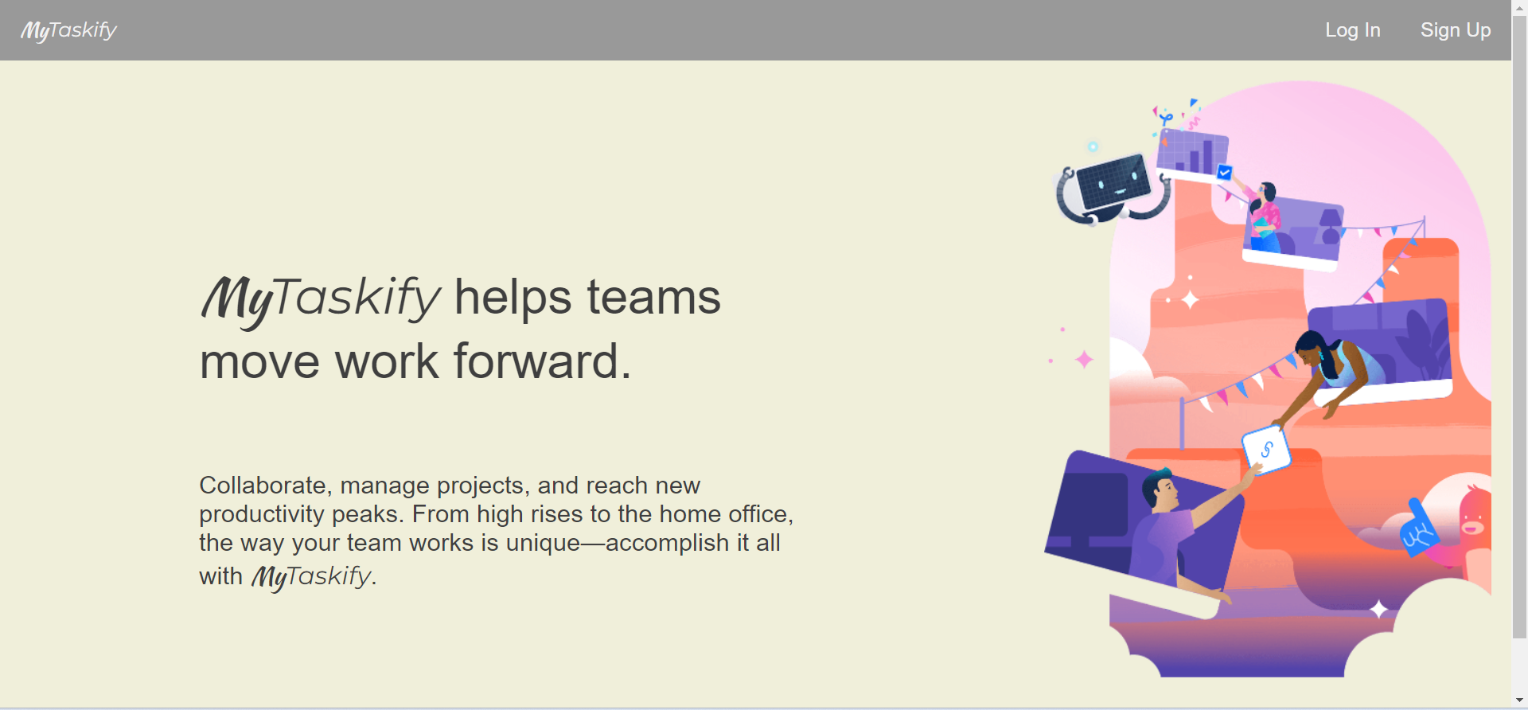
Application Screenshots
12 April 2022

Slide 10
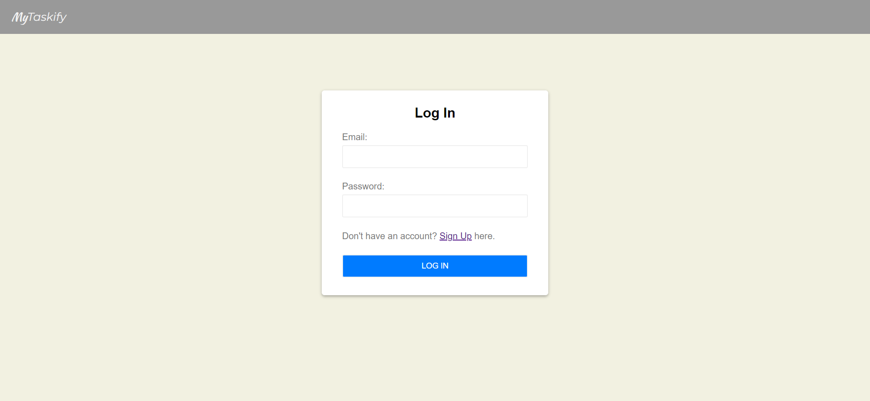
Application Screenshot
12 April 2022

Slide 11
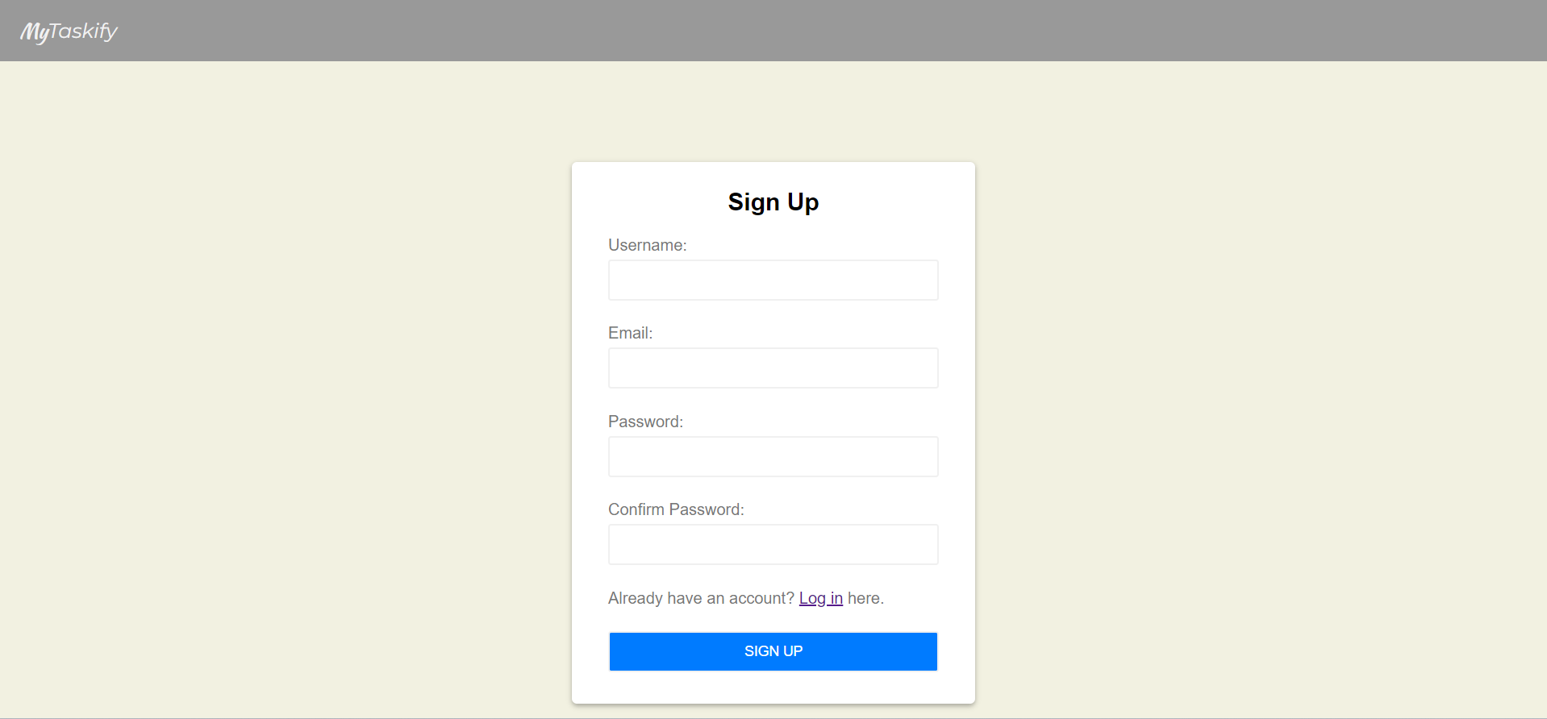
Application Screenshot
12 April 2022

Slide 12
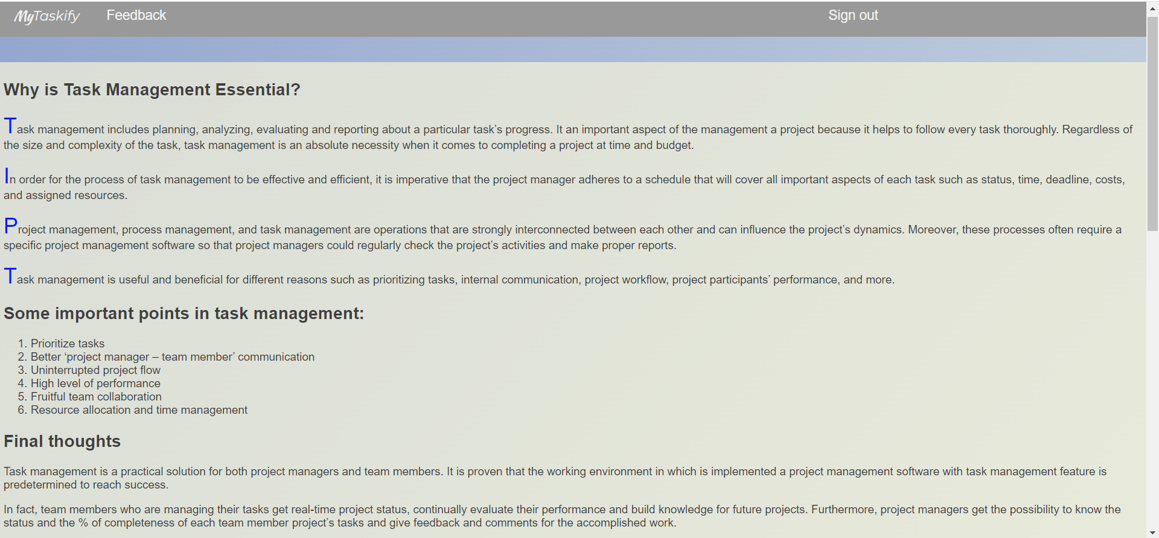
Application Screenshot
12 April 2022

Slide 13
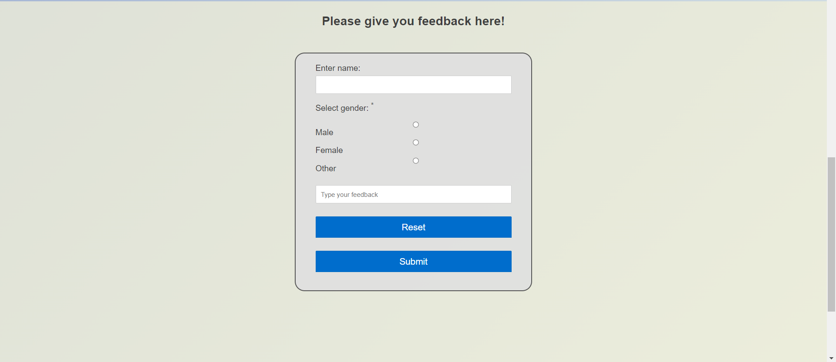
Application Screenshot
12 April 2022

Slide 14
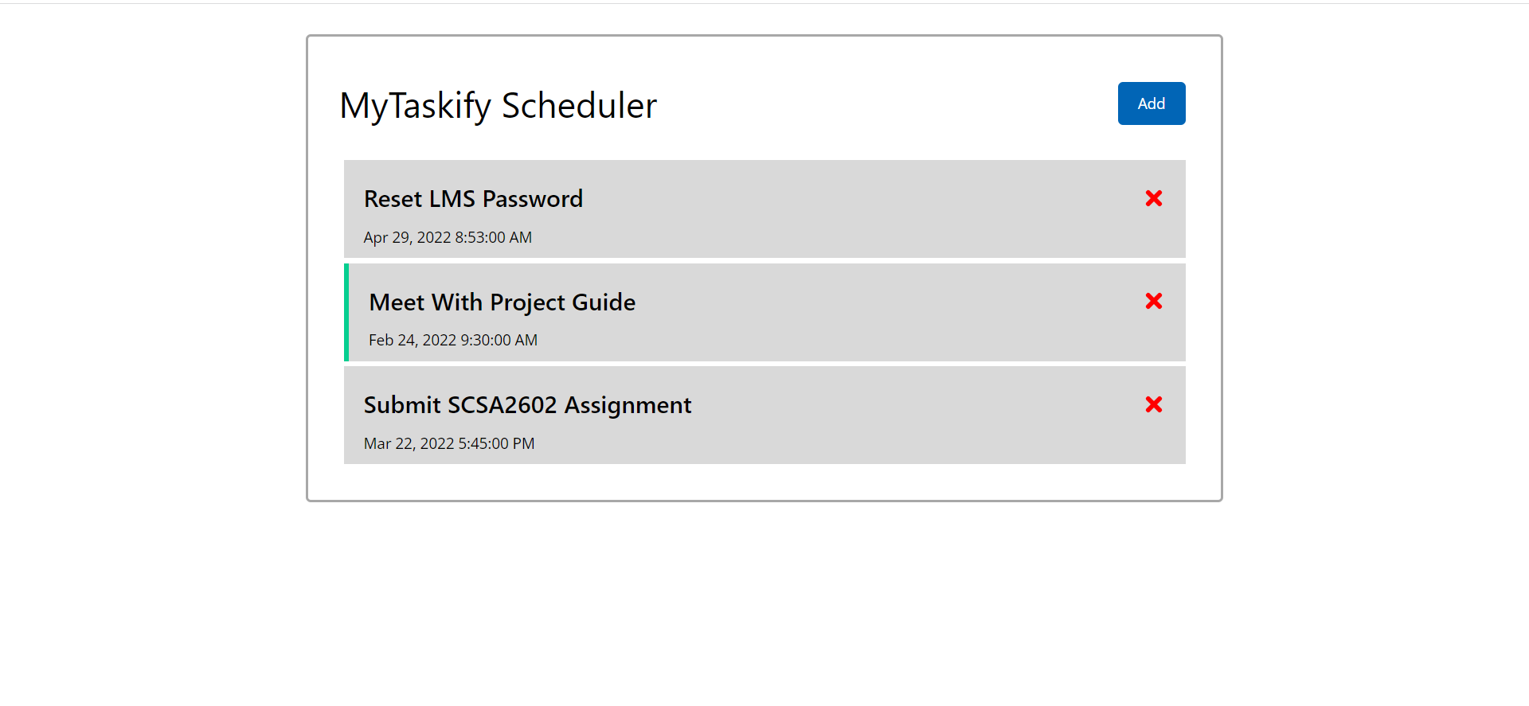
Application Screenshot
12 April 2022

Slide 15
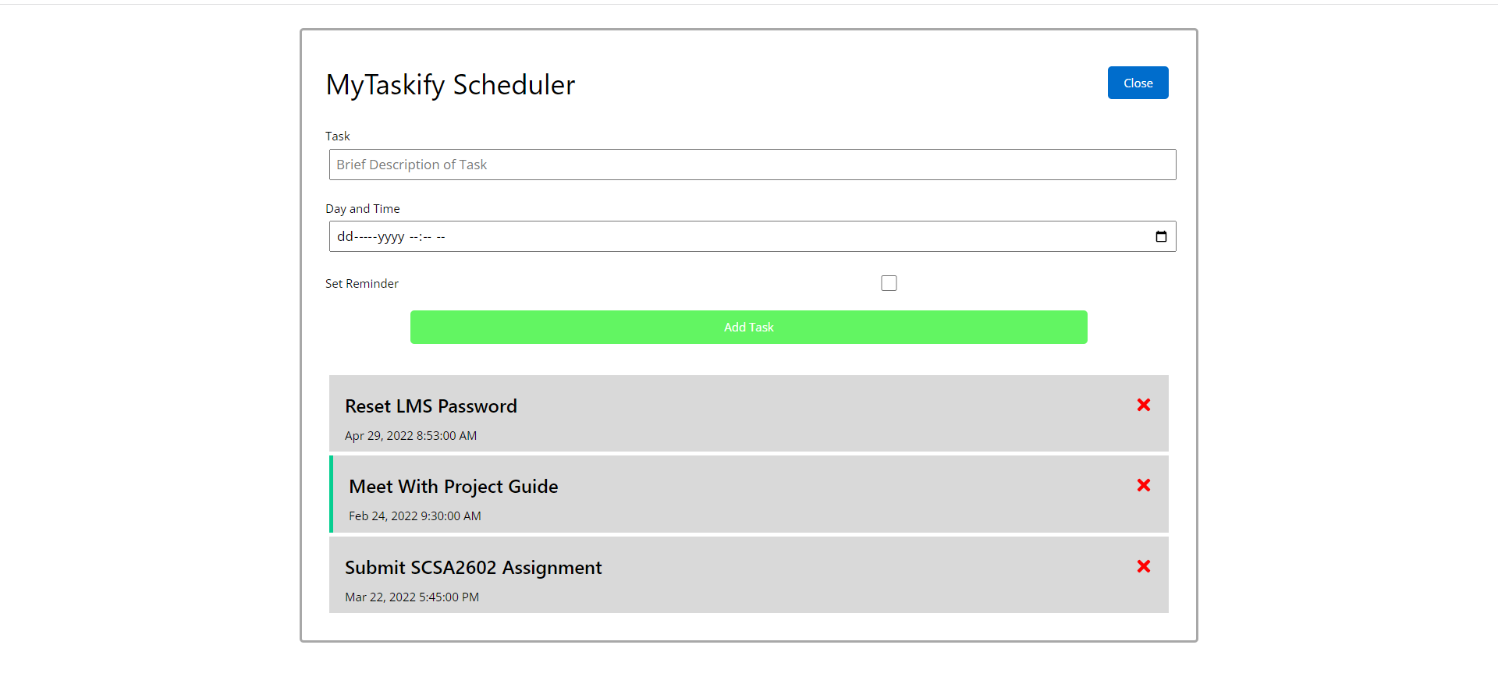
Application Screenshot
12 April 2022

Slide 16
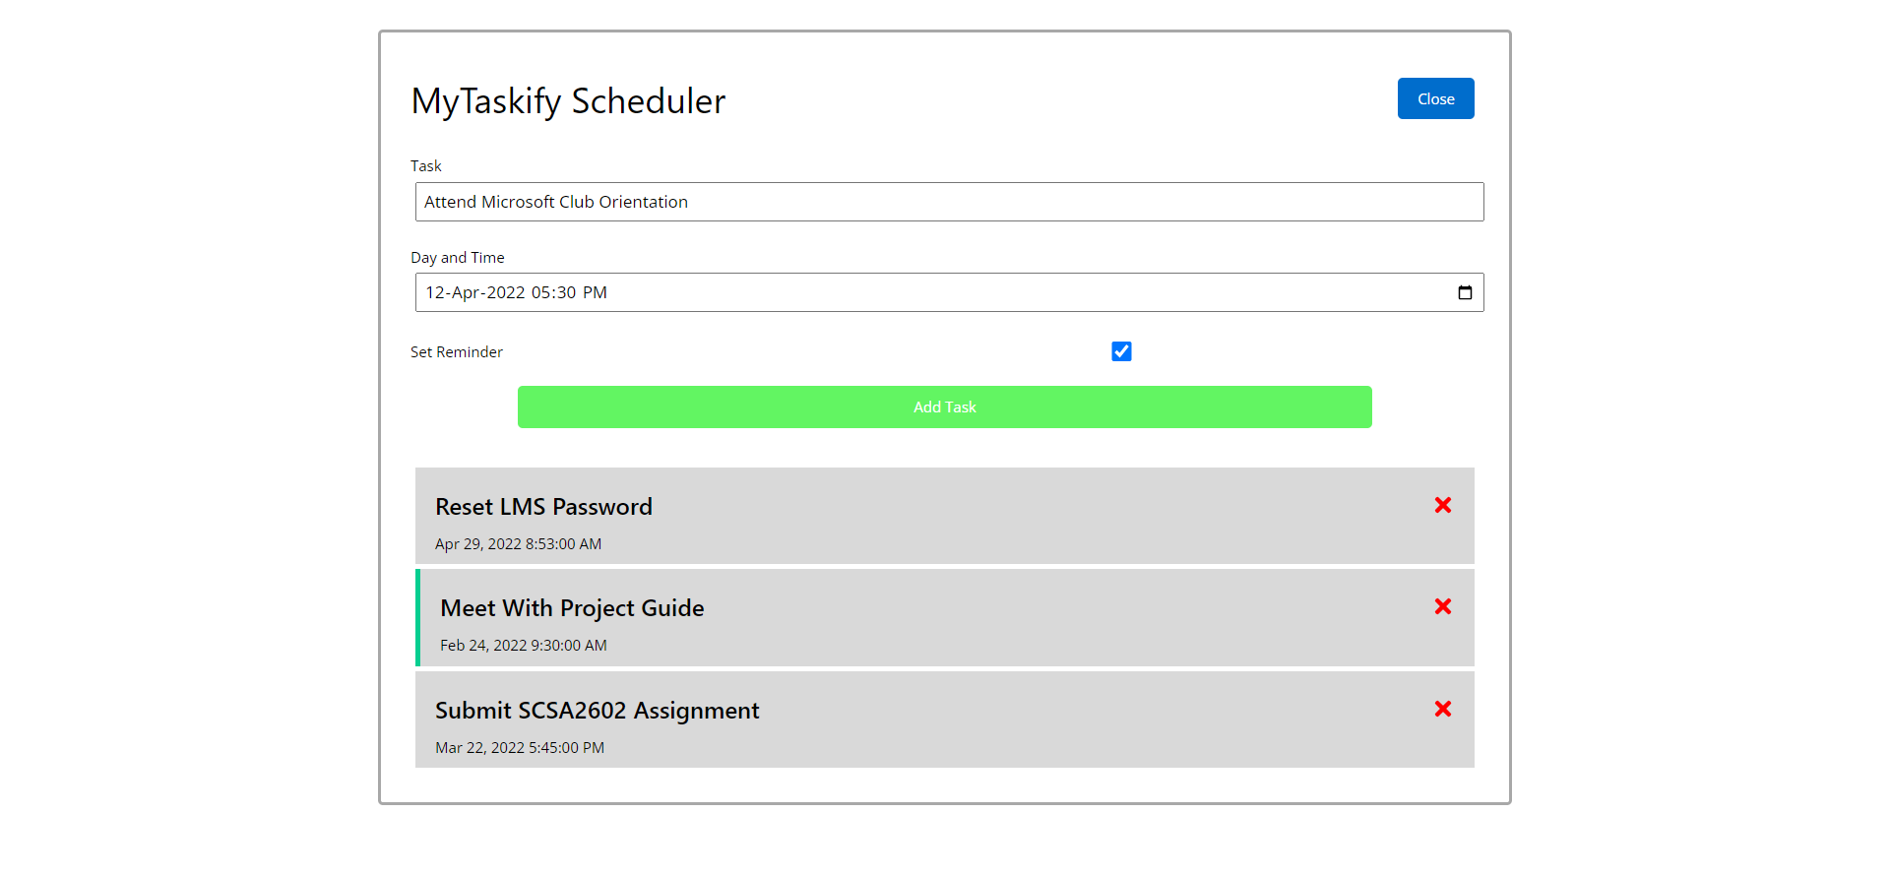
Application Screenshot
12 April 2022

Slide 17
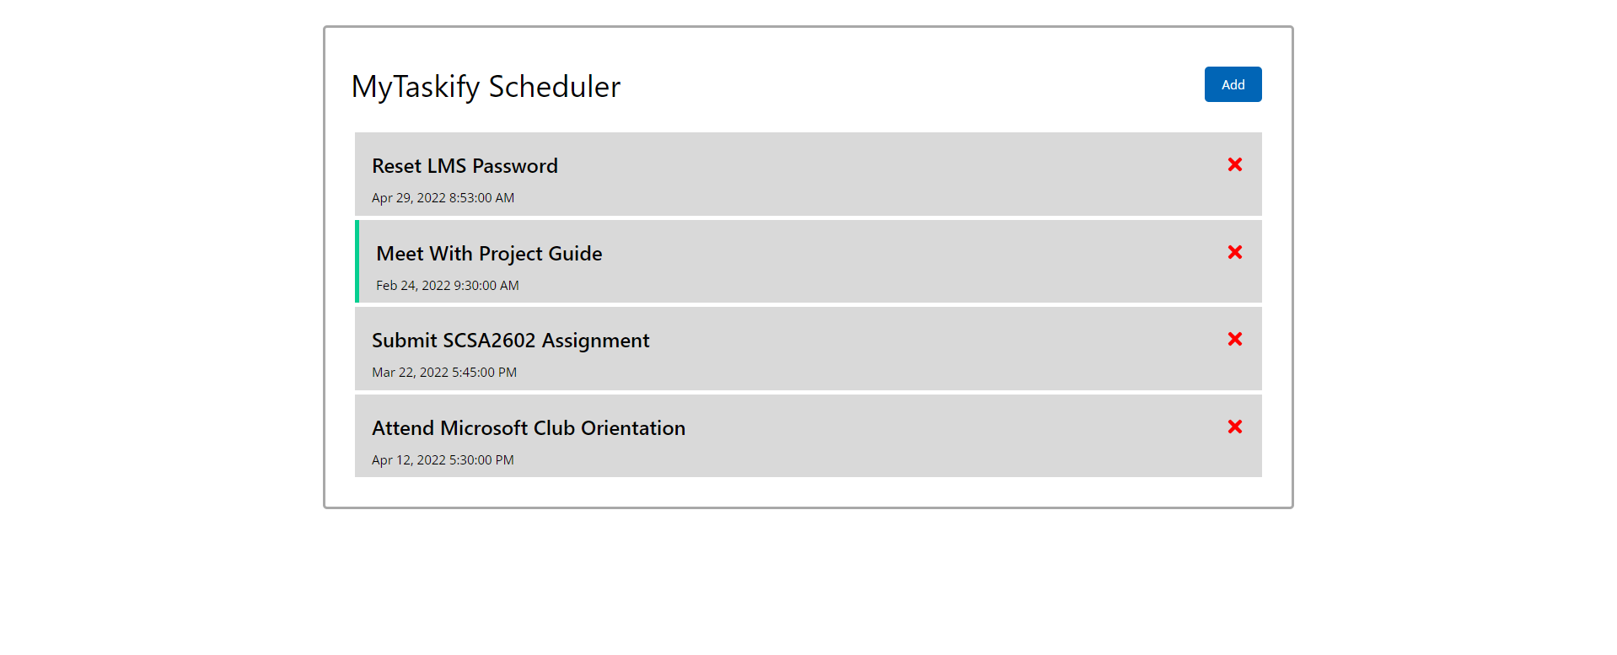
Application Screenshot
12 April 2022

Slide 18
Learning Outcome and Result
Learning Outcome:
Coggle to create the ideation map.
HTML to create basic webpage
AngularJS to create the application
Result:
A Task Management application,
“MyTaskify- the Task Manager”
12 April 2022

Slide 19
Conclusion & Future Scope
Conclusion :
I state that this project has helped me gain hands-on experience and enhance my knowledge with UI/UX designing, technical & interpersonal skills.
Future Work:
UI/UX Designer.
Front-end AngularJS developer.
Development manager.
12 April 2022

Slide 20
References
[1] AngularJs - Credo Systemz course.
[2] AngularJs - CodeWithHarry Youtube Channel
[3] AngularJs - Programming with Mosh Youtube Channel
[4] AngularJs - www.angularjs.org Official Documentation
[] HTML - Credo Systemz
12 April 2022

